Slide 1
Web app development
727821TUEC018 - ANUVARSHINI G

Slide 2
Overview
This project will be designed using React js.
The example of phone directory will be used for this app development.
Sample of how the web app will be implemented is created using Figma
The sample webpage can be accessed by clicking the below link : https://www.figma.com/proto/1LLBlz59bc2gk6z1WQlmkP/Untitled?node-id=1%3A8&scaling=scale-down&page-id=0%3A1&starting-point-node-id=1%3A8
It consists of 3 pages as Sign in page,sign up page and a page that contains phone directory respectively.
It shows implementation of project

Slide 3
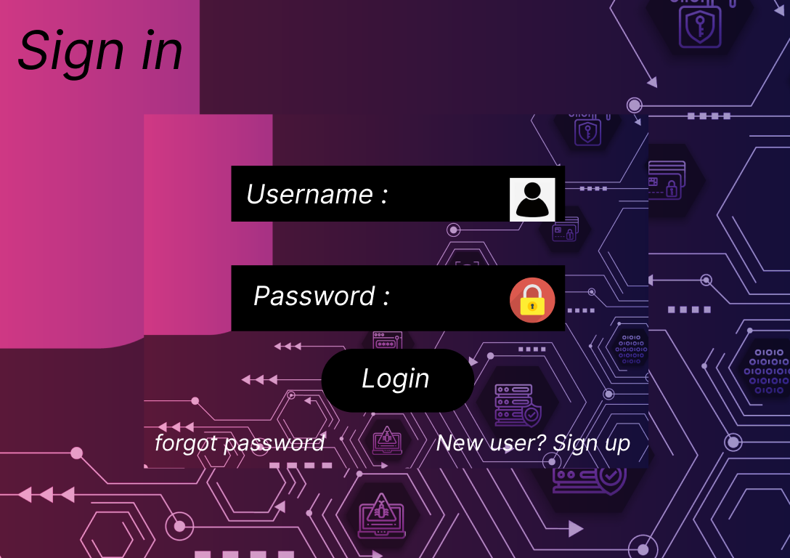
1. Sign in page

Slide 4
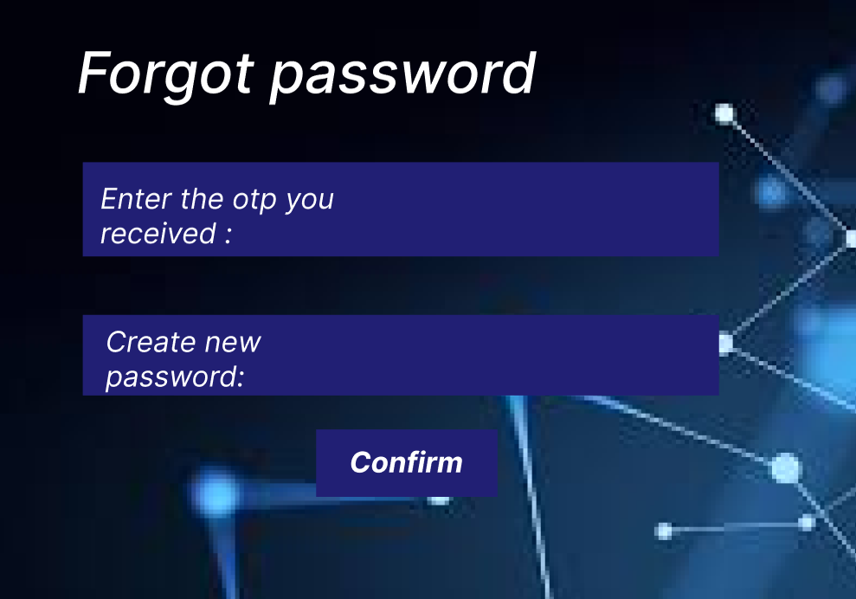
2.Forgot password page

Slide 5
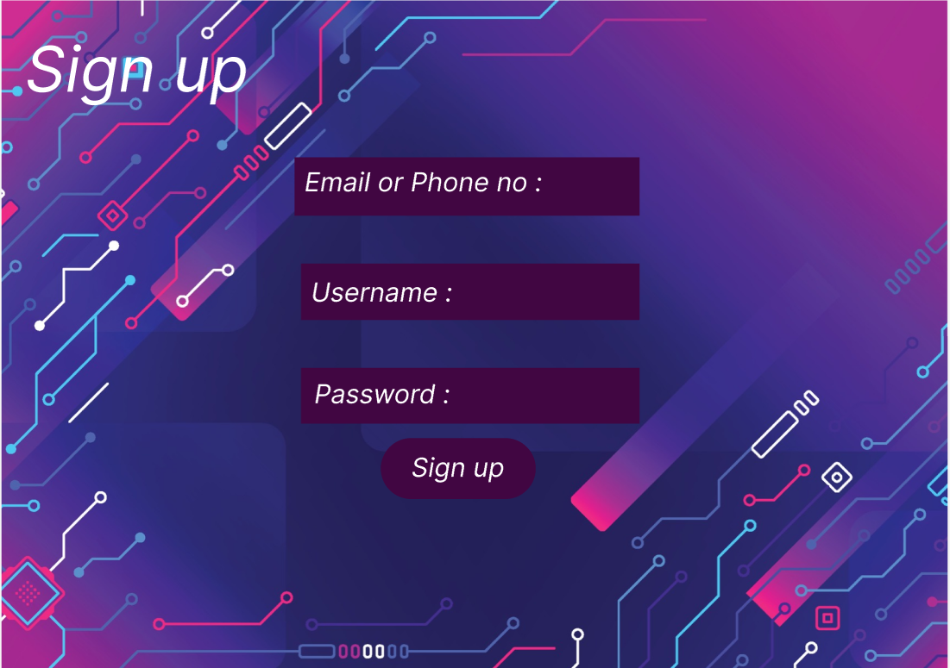
3.Sign up page

Slide 6
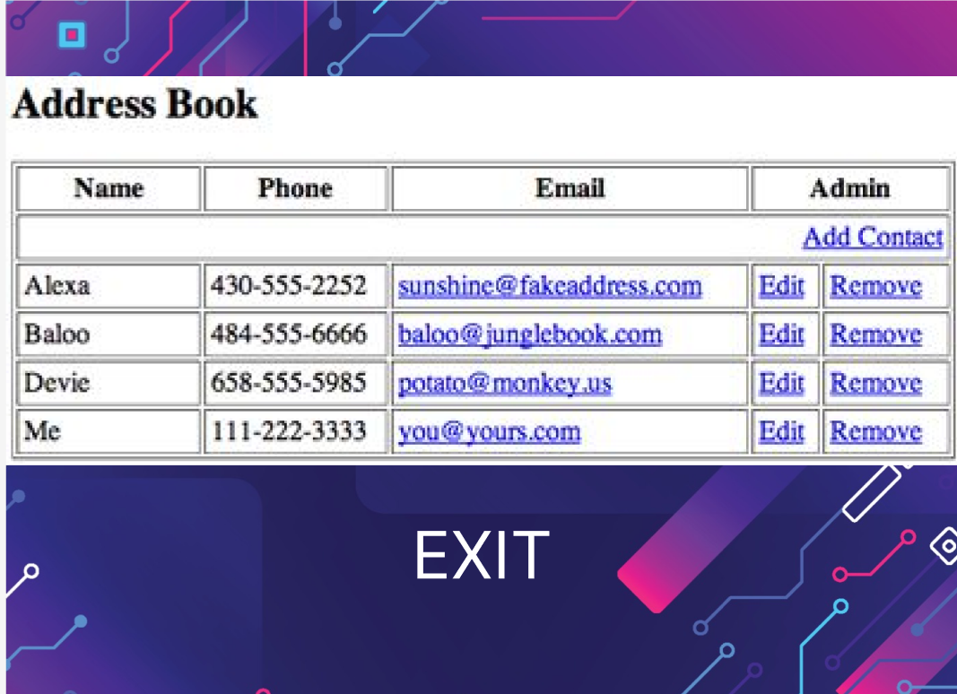
4.Sample output

Slide 7


